Slide 1
AT&T Case Competition
Social media reviews and retail performance correlation
Maithreya Chakravarthula
Phillip Watz

Slide 2
“Selling does not lead to sales, Service does.”
What is the aim of AT&T retail stores?
Facts collected about AT&T retail stores.
AT&T has converted more than 700 of its stores nationwide to bilingual locations
AT&T has more than 16,000 retail locations in the U.S.
RETAIL STORES
Notes:
http://www.att.com/Common/merger/files/pdf/Retail_from_ATT-FS.pdf

Slide 3
“Customers do not expect you to be perfect. They do expect you to fix things when they go wrong.”
About the customers
How does AT&T measure satisfaction?
Relationship Satisfaction:
Net Promoter Score, NPS
Transactional Satisfaction
Behavioral Outcomes
CUSTOMERS
Notes:
http://about.att.com/apps/csr/services/IssueBriefBuilder.pdf?download=people/customer-experience-and-satisfaction

Slide 4
“Social media is the ultimate equalizer. It gives a voice and a platform to anyone willing to engage.”
Currently on Twitter (ATTCares) and Facebook.
Through private chat on website and online forums.
20 million online chat sessions in 2015
Approximately 134,000 user-generated posts
More than 5,000 exclusive retail locations
SOCIAL MEDIA
Notes:
http://about.att.com/content/csr/home/issue-brief-builder/people/customer-experience-and-satisfaction.html

Slide 5
Methodology Used:
Collected info. through forms and surveys
Categorized them based off of Nationality
Used the Hofstede’s Theory of Cultural Dimensions to understand customer sentiments
Ran regression analysis: to find correlation amongst various factors collected through surveys

Slide 6
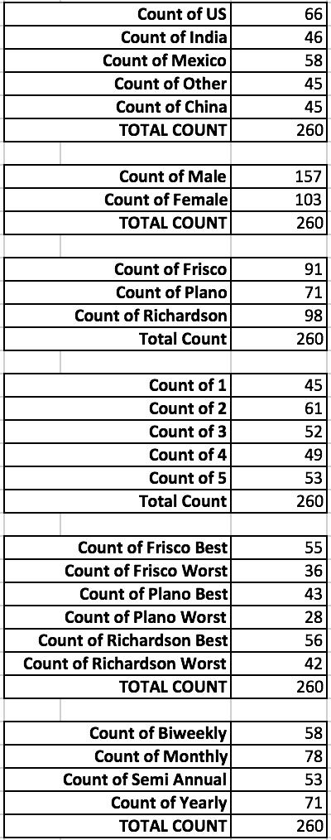
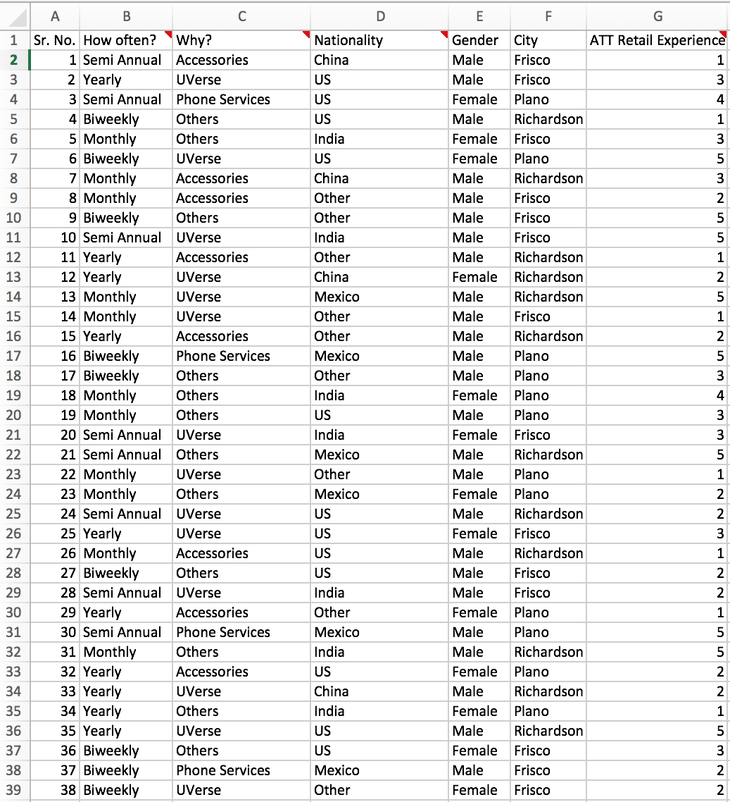
Survey Results Sample

Slide 7
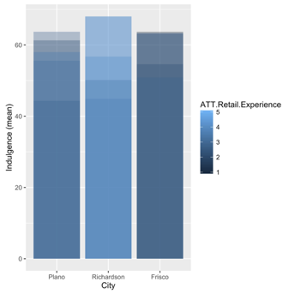
Survey Analysis:
Indulgence: Society that allows relatively free gratification of natural human drives related to enjoying life and having fun.
An indulgence mean:
Plano : 62
Richardson : 64
Frisco : 62
Interesting Observation: Although the indulgence scores are around the same, the ATT Retail Experience varies drastically

Slide 8
Our Findings:
AT&T has presence in Twitter and Facebook
Twitter Customer Service (ATTCares) & Individual Retail FB pages
Primarily used for posting news & updates
Low response rate to customers

Slide 9
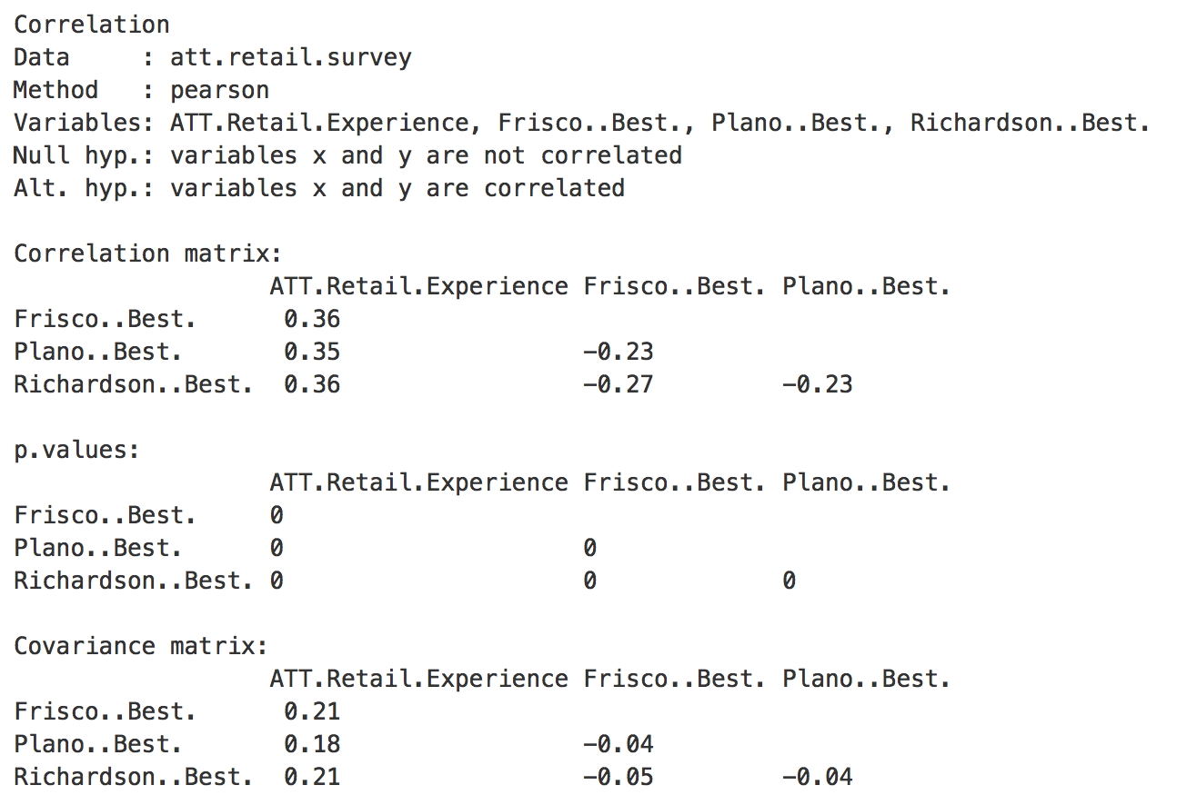

Correlation Matrix:
Notes:
Without sales numbers or benchmarks these stats are useless

Slide 10
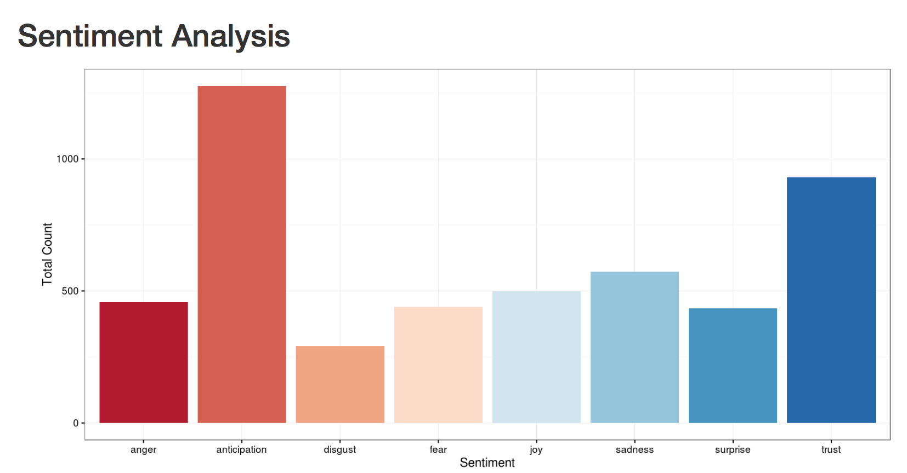
Customer Sentiment Analysis
Anger + Sadness + Disgust + Fear = 1600
Anticipation = 1500
Trust = 900
Less than 35 % of customers on Twitter are Positive about AT&T’s Service!!

Slide 11
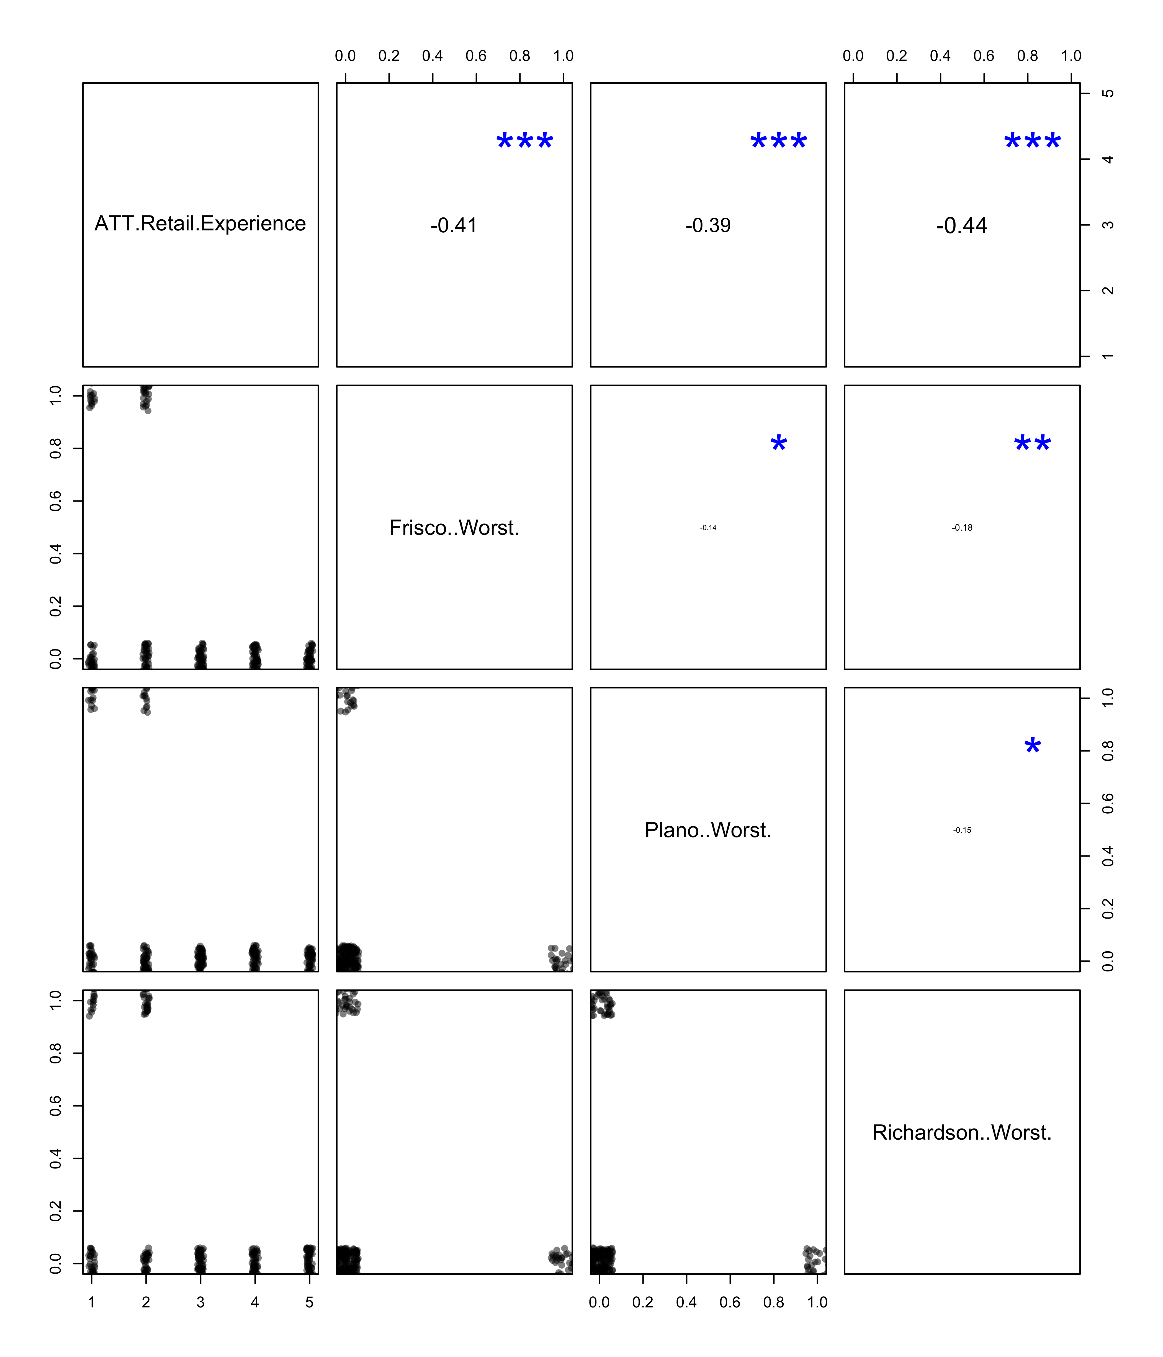
Correlation Matrix: (AT&T exp. vs Worst by city)
Notes:
Without sales numbers or benchmarks these stats are useless

Slide 12
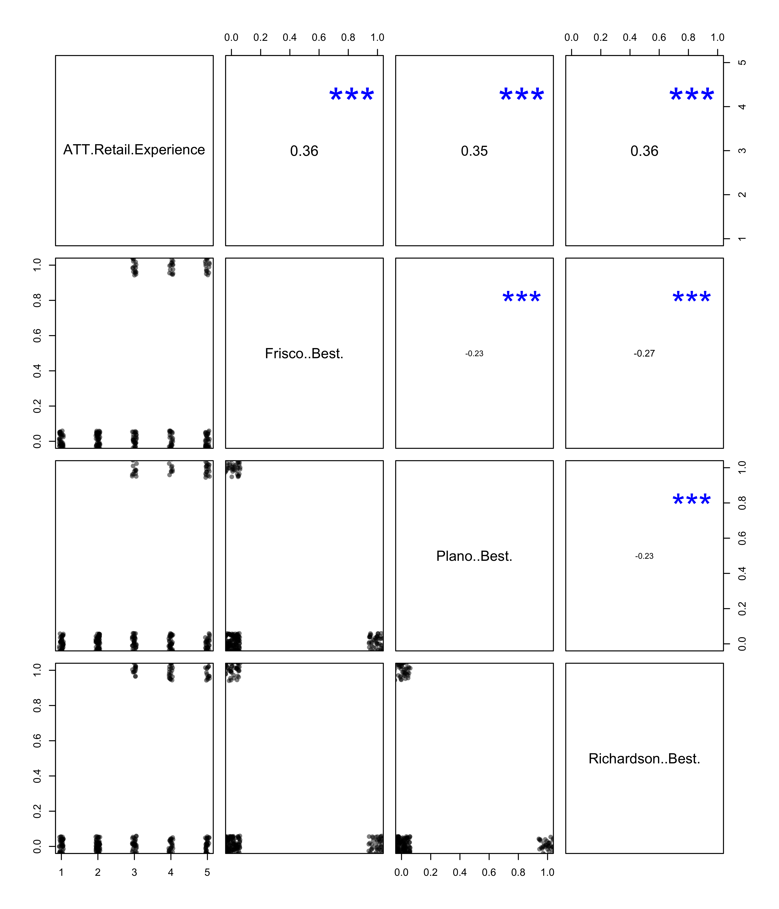
Correlation Matrix: (AT&T exp. vs Best by city)
Notes:
Without sales numbers or benchmarks these stats are useless

Slide 13
Recommendations:
Centrally monitored customer review system on a per retail store basis
Example: Being a previous AT&T Customer, I remember each time I walk into the store and get help, I would receive a call minutes later I walk out the store. On a scale of 9, I was asked to rate the experience in the store.
When I do this, why would I want to use social media?
Easy to manipulate the true reviews of customers coming in through this system.

Slide 14
Recommendations:
Individual Retailers running and actively responding to comments on social media
Getting to know your customers
Respond to customer complaints on Social Sites such as Google Reviews and Yelp!

Slide 15
If we had time, resources and the knowledge…
We had access to some of the sales data of some of the top ten retail stores in DFW area, we could have tallied them and tied them up with ratings and responses to see how accurate their reviews were
Go into the depths of understanding customer sentiments and give feedback based on demographics, rather than a generic recommendation
Talk to customers and then provide insights, than just statistically validating them!

Slide 16
Thank you!
QUESTIONS?

